Slide 1
KINDERGARTEN MANAGEMENT SYSTEM
GROUP 15

Slide 2
INTERFACE FOR ADMIN

Slide 3
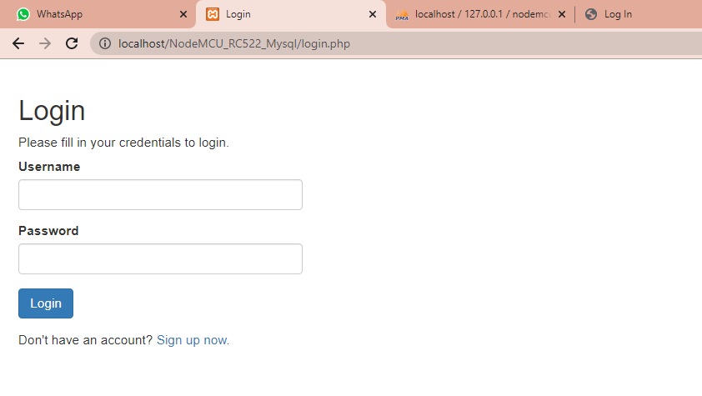
Slide 4

Slide 4
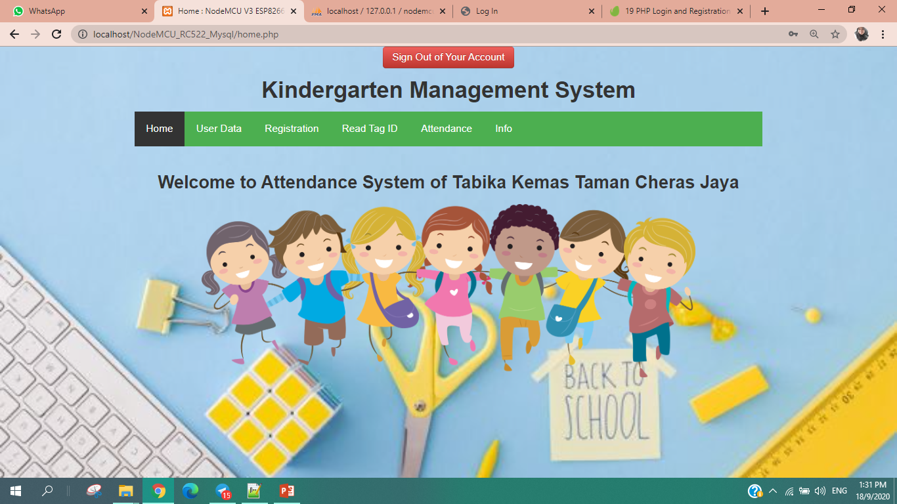
Slide 5
Slide 8
Slide 9
Slide 10

Slide 5
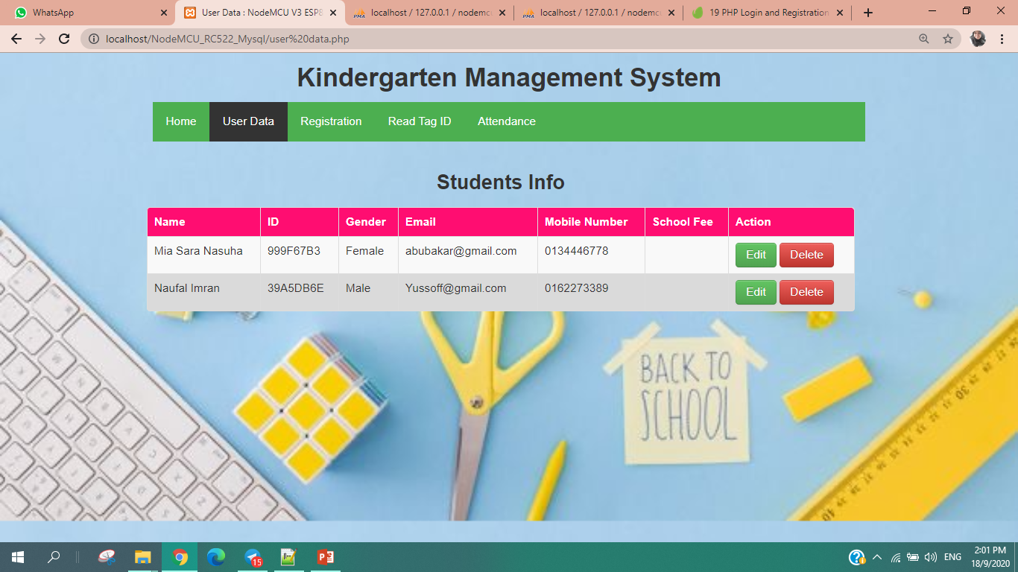
Slide 6
Slide 7

Slide 6
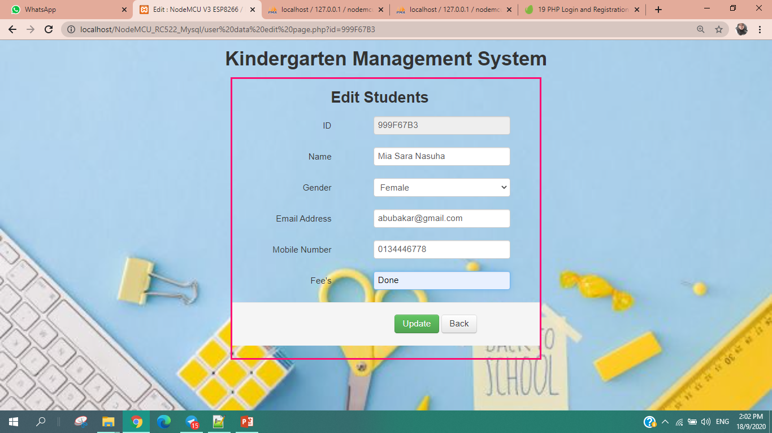
Slide 5

Slide 7
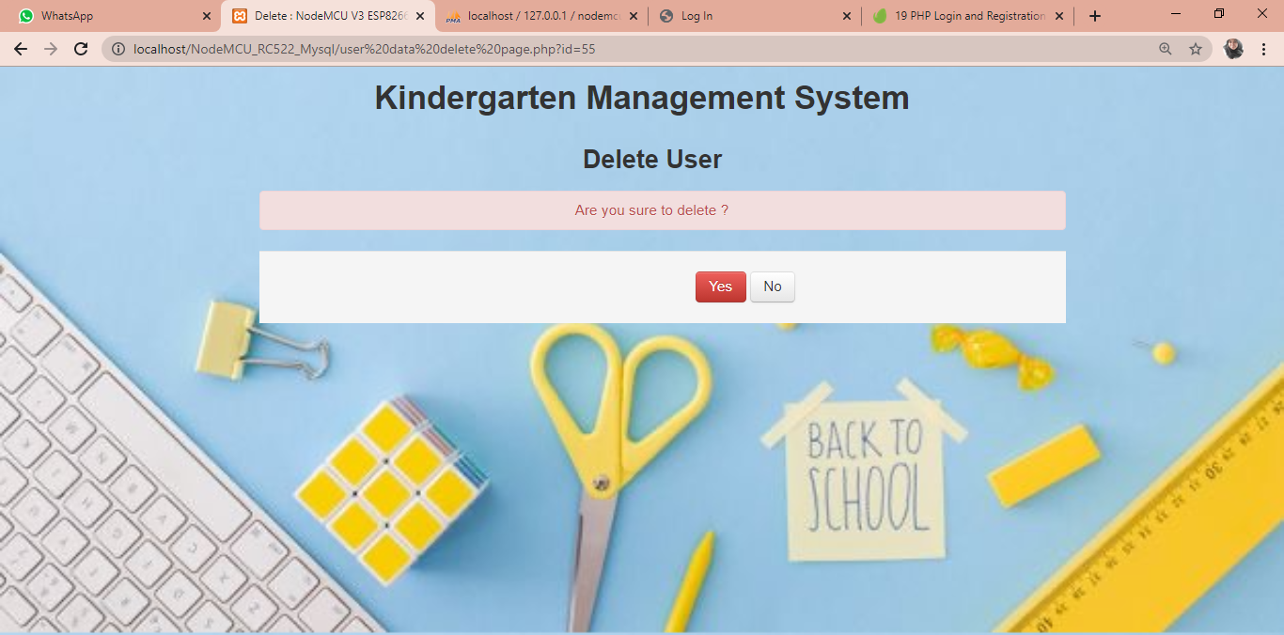

Slide 8
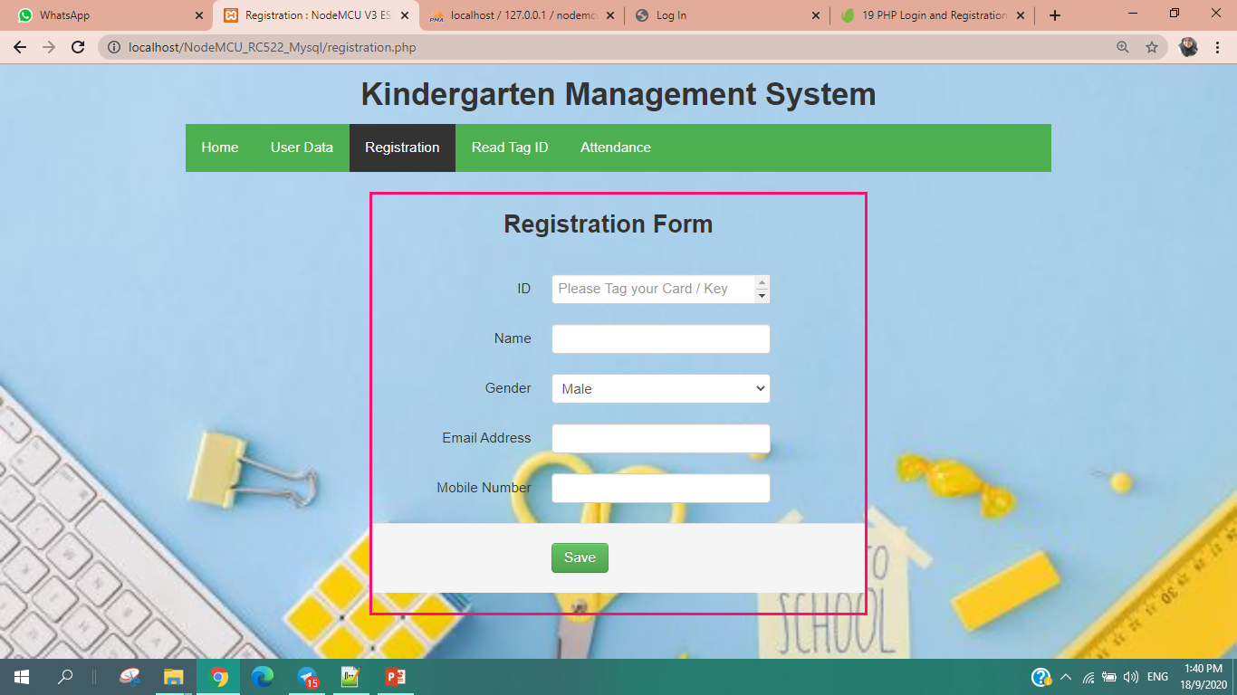

Slide 9
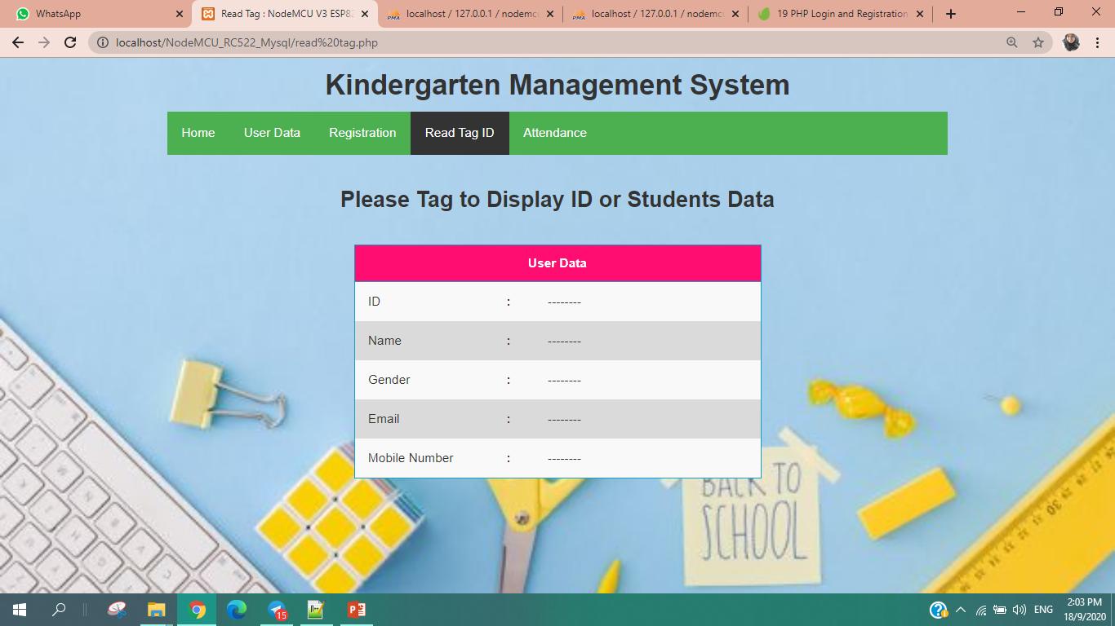

Slide 10
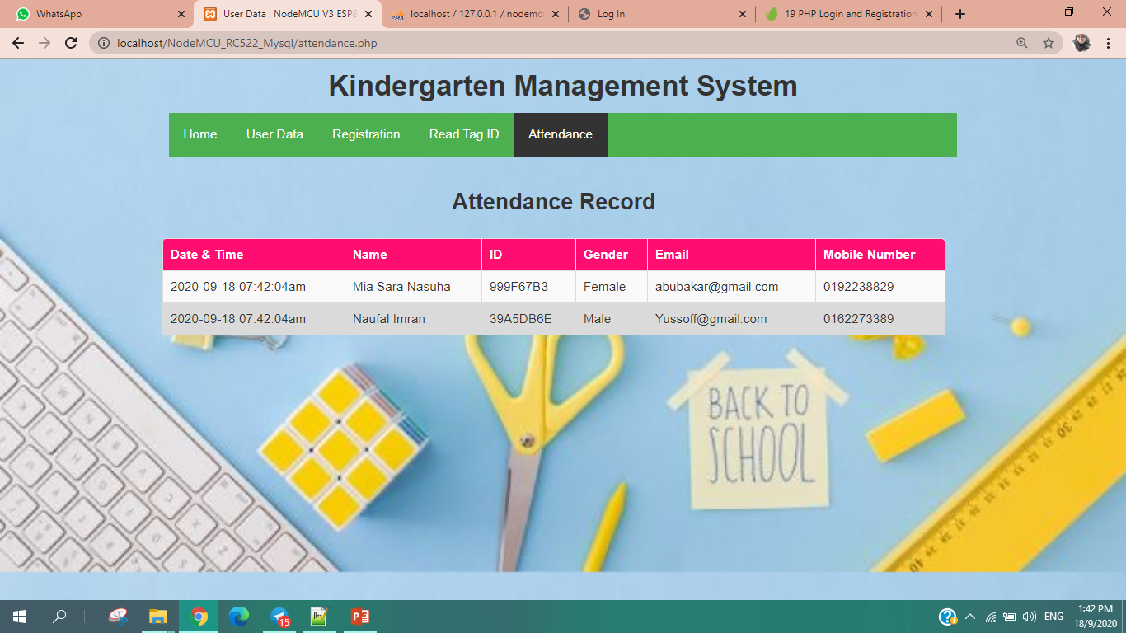

Slide 11
INTERFACE FOR PARENTS

Slide 13
